Slide 1
COM1013
INTRODUCTION TO COMPUTER SCIENCE
Lecturer: Begüm MUTLU BİLGE, PhD
begummutlubilge+com1013@gmail.com (recommended)
bmbilge@ankara.edu.tr

Slide 2
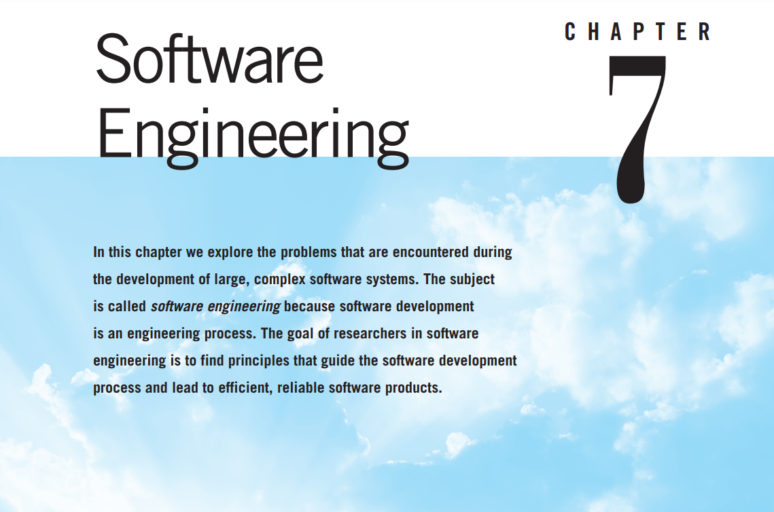

Slide 3
Software Engineering
Software engineering is the branch of computer science that seeks principles to guide the development of large, complex software systems.
Includes topics such as personnel and project management
Notes:
Software engineering is the branch of computer science that seeks principles to guide the development of large, complex software systems.
The problems faced when developing such systems are more than enlarged versions of those problems faced when writing small programs.
For instance, the development of such systems requires the efforts of more than one person over an extended period of time during which the requirements of the proposed system may be altered and the personnel assigned to the project may change.
Consequently, software engineering includes topics such as personnel and project management that are more readily associated with business management than computer science.

Slide 4

Software Engineering
Lets select a large complex device (may be an automobile) and imagine being asked to design it and then to supervise its construction.
Notes:
To appreciate the problems involved in software engineering, it is helpful to select a large complex device (an automobile) and imagine being asked to design it and then to supervise its construction.

Slide 5
Software Engineering
Questions must be answered during the development of a large software system.
How can you estimate the cost in time, money, and other resources to complete the project?
How can you divide the project into manageable pieces?
How can you ensure that the pieces produced are compatible?
How can those working on the various pieces communicate?
How can you measure progress?
How can you cope with the wide range of detail?

Slide 6
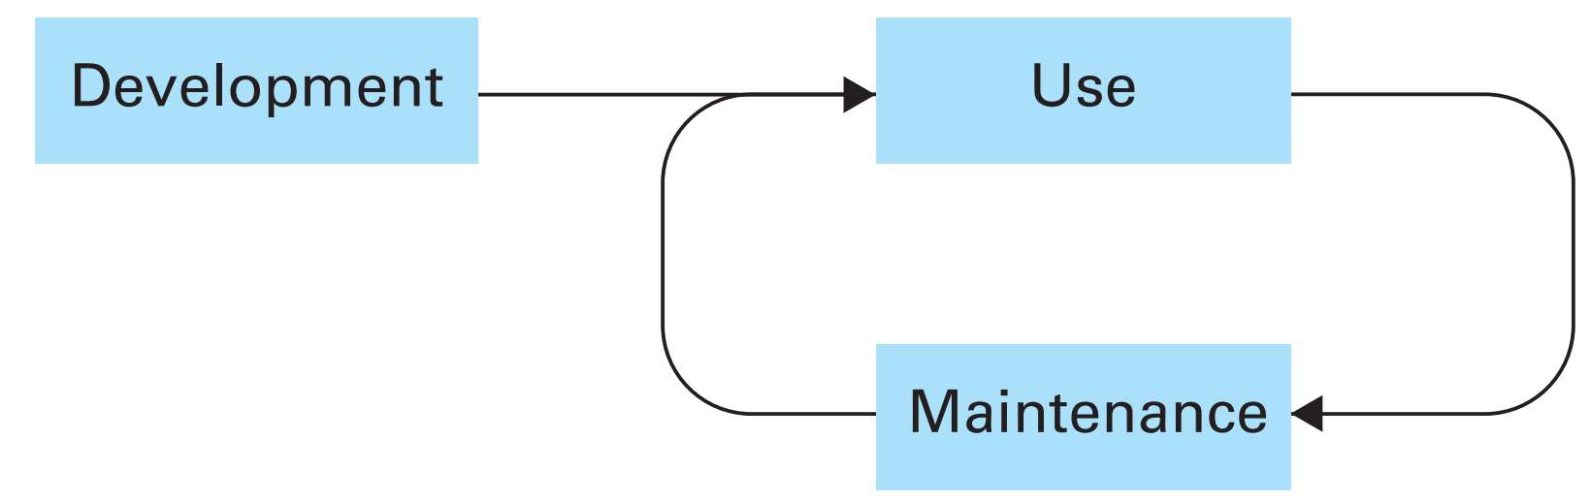
The Software Life Cycle
Notes:
The most fundamental concept in software engineering is the software life cycle.
The Cycle as a Whole
The software life cycle is shown in Figure 7.1. This figure represents the fact that
once software is developed, it enters a cycle of being used and maintained—a
cycle that continues for the rest of the software’s life. Such a pattern is common for many manufactured products as well. The difference is that, in the case of other products, the maintenance phase tends to be a repair process, whereas in the case of software, the maintenance phase tends to consist of correcting or updating. Indeed, software moves into the maintenance phase because errors are discovered, changes in the software’s application occur that require corresponding changes in the software, or changes made during a previous modification are found to induce problems elsewhere in the software.
Regardless of why software enters the maintenance phase, the process requires that a person (often not the original author) study the underlying program and its documentation until the program, or at least the pertinent part of the program, is understood. Otherwise, any modification could introduce more problems than it solves. Acquiring this understanding can be a difficult task, even when the software is well-designed and documented. In fact, it is often within this phase that a piece of software is discarded under the pretense (too often true) that it is easier to develop a new system from scratch than to modify the existing package successfully. Experience has shown that a little effort during the development of software can make a tremendous difference when modifications are required. For example, in our discussion of data description statements in Chapter 6 we saw how the use of constants rather than literals can greatly simplify future adjustments. In turn, most of the research in software engineering focuses on the development stage of the software life cy

Slide 7
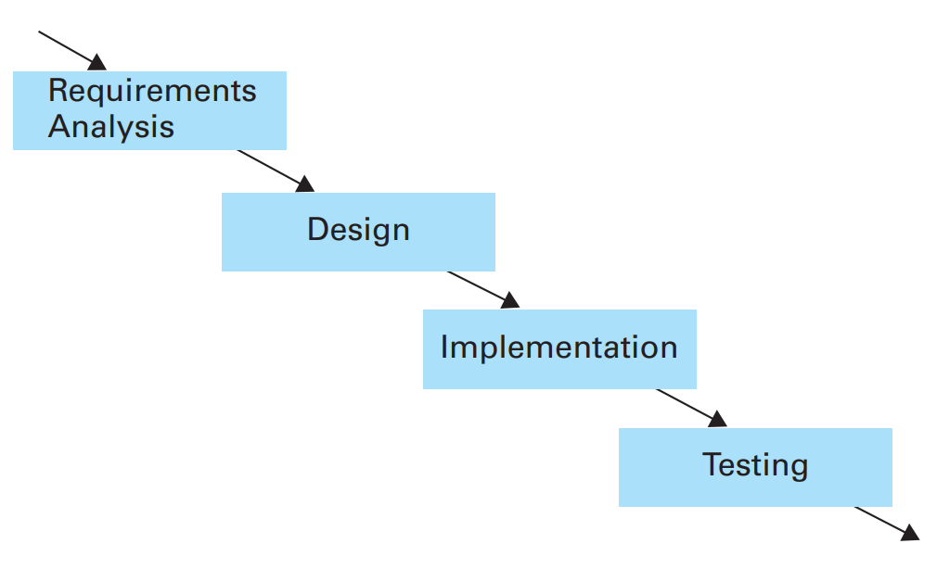
The Traditional Development Phase
Notes:
The major steps in the traditional software development life cycle are requirements analysis, design, implementation, and testing.

Slide 8
Requirements Analysis
The software life cycle begins with requirements analysis
The goal: to specify what services the proposed system will provide,
To identify any conditions (time constraints, security, and so on) on those services,
To define how the outside world will interact with the system.
Notes:
The software life cycle begins with requirements analysis—the goal of which is to specify what services the proposed system will provide, to
identify any conditions (time constraints, security, and so on) on those services,
and to define how the outside world will interact with the system.

Slide 9
Requirements Analysis
The requirements analysis process:
Compiling and analyzing the needs of the software user;
Negotiating with the project’s stakeholders
over trade-offs between wants, needs, costs, and feasibility;
Developing a set of requirements
that identify the features and services that the finished software system must have.
Notes:
The requirements analysis process consists of compiling and analyzing the needs of the software user; negotiating with the project’s stakeholders over trade-offs between wants, needs, costs, and feasibility; and finally developing a set of requirements that identify the features and services that the finished software system must have

Slide 10
Requirements Analysis
Requirements are recorded in a document called a Software Requirements Specification (SRS).
A written agreement between all parties concerned,
Intends to guide the software’s development and
provides a means of resolving disputes that may arise later in the development process.
Professional organizations such as IEEE and large software clients such as the U.S. Department of Defense have adopted standards.
Straightforward and frequent communication with the project’s stakeholders is mandatory.
Notes:
These requirements are recorded in a document called a software requirements specification
In a sense, this document is a written agreement between all parties concerned, which is intended to guide the software’s development and provide a means of resolving disputes that may arise later in the development process.

Slide 11
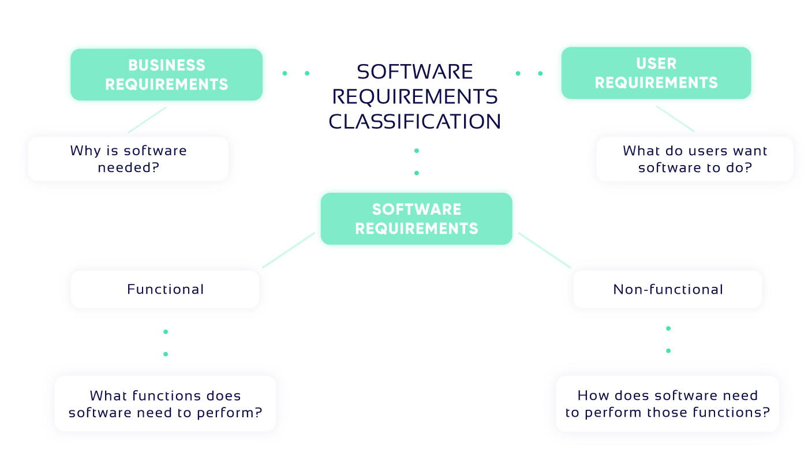
Requirements Analysis
Notes:
Figure from: https://light-it.net/blog/how-to-write-a-software-specification/
Business Requirements
A person who drafts the document explains why the client needs this software and what business goals must be achieved. This information is entirely provided by a client. For example, a clinic owner wants to minimize administrative work to save money they would have spent on personnel and hardware. A solution for the clinic could be a fully-functional doctor booking app that will automate all the administrative processes and, thereby, help an owner achieve their business goal.
User Requirements
This type of requirements specifies goals and tasks that a user can accomplish while interacting with software. If to get back to the example of a doctor appointment mobile app software requirements specification, one of the most typical scenarios to include would be a patient’s ability to make or cancel a doctor’s appointment. The point is to define and indicate in the specification as many user stories as possible.
Functional Requirements
Functional requirements define the behavior of a product under different circumstances or user scenarios. They point out what developers must do to make it easier for users to accomplish their tasks. See the examples of how to phrase software features:
3.1 Booking a Doctor’s Appointment
A user shall be provided with the ability to confirm an appointment
A user shall be able to cancel an appointment
… (etc.).
3.2 Reviews and Ratings Feature
Software shall allow a user to rate doctors
… (etc.).
Non-Functional Requirements
Non-functional requirements, also known as software attributes, do not describe what software does, the focus here is on how well software performance is. This type helps to set the constraints that could come along with a project under development. Complex projects can have an extensive list of attributes, but only some of them are described in detail. These attributes are:
Usability;
Safety;
Security;
Reliability;
Testability;
Scalability;
Integrability;
Extensibility;
and others.

Slide 12
Design
Whereas requirements analysis provides a description of the proposed software product,
design involves creating a plan for the construction of the proposed system.
Requirements analysis is about identifying the problem to be solved (what),
while design is about developing a solution to the problem (how).
Diagramming and modeling
Notes:
Whereas requirements analysis provides a description of the proposed software product, design involves creating a plan for the construction of the proposed system.
Requirements analysis is about identifying the problem to be solved, while design is about developing a solution to the problem.
Diagramming and modeling play important roles in the design of software.
However, the methodologies and notational systems used by software engineers are not stable.
The practice of software engineering appears very dynamic as researchers struggle to find better approaches to the software development process.

Slide 13
Implementation
Implementation involves the actual writing of programs, creation of data files, and development of databases.
A programmer is charged with writing programs that implement the design produced by a software analyst.
Notes:
Implementation involves the actual writing of programs, creation of data files, and development of databases.
It is at the implementation stage that we see the distinction between the tasks of a software analyst and a programmer.
The analyst is a person involved with the entire development process, perhaps with an emphasis on the requirements analysis and design steps.
The programmer is a person involved primarily with the implementation step. In its narrowest interpretation, a programmer is charged with writing programs that implement the design produced by a software analyst

Slide 14
Testing
The result of each intermediate step in the entire development process should be “tested” for accuracy.
In the traditional development phase of the past, testing was essentially equated with
the process of debugging programs and
confirming that the final software product was compatible with the SRS.

Slide 15
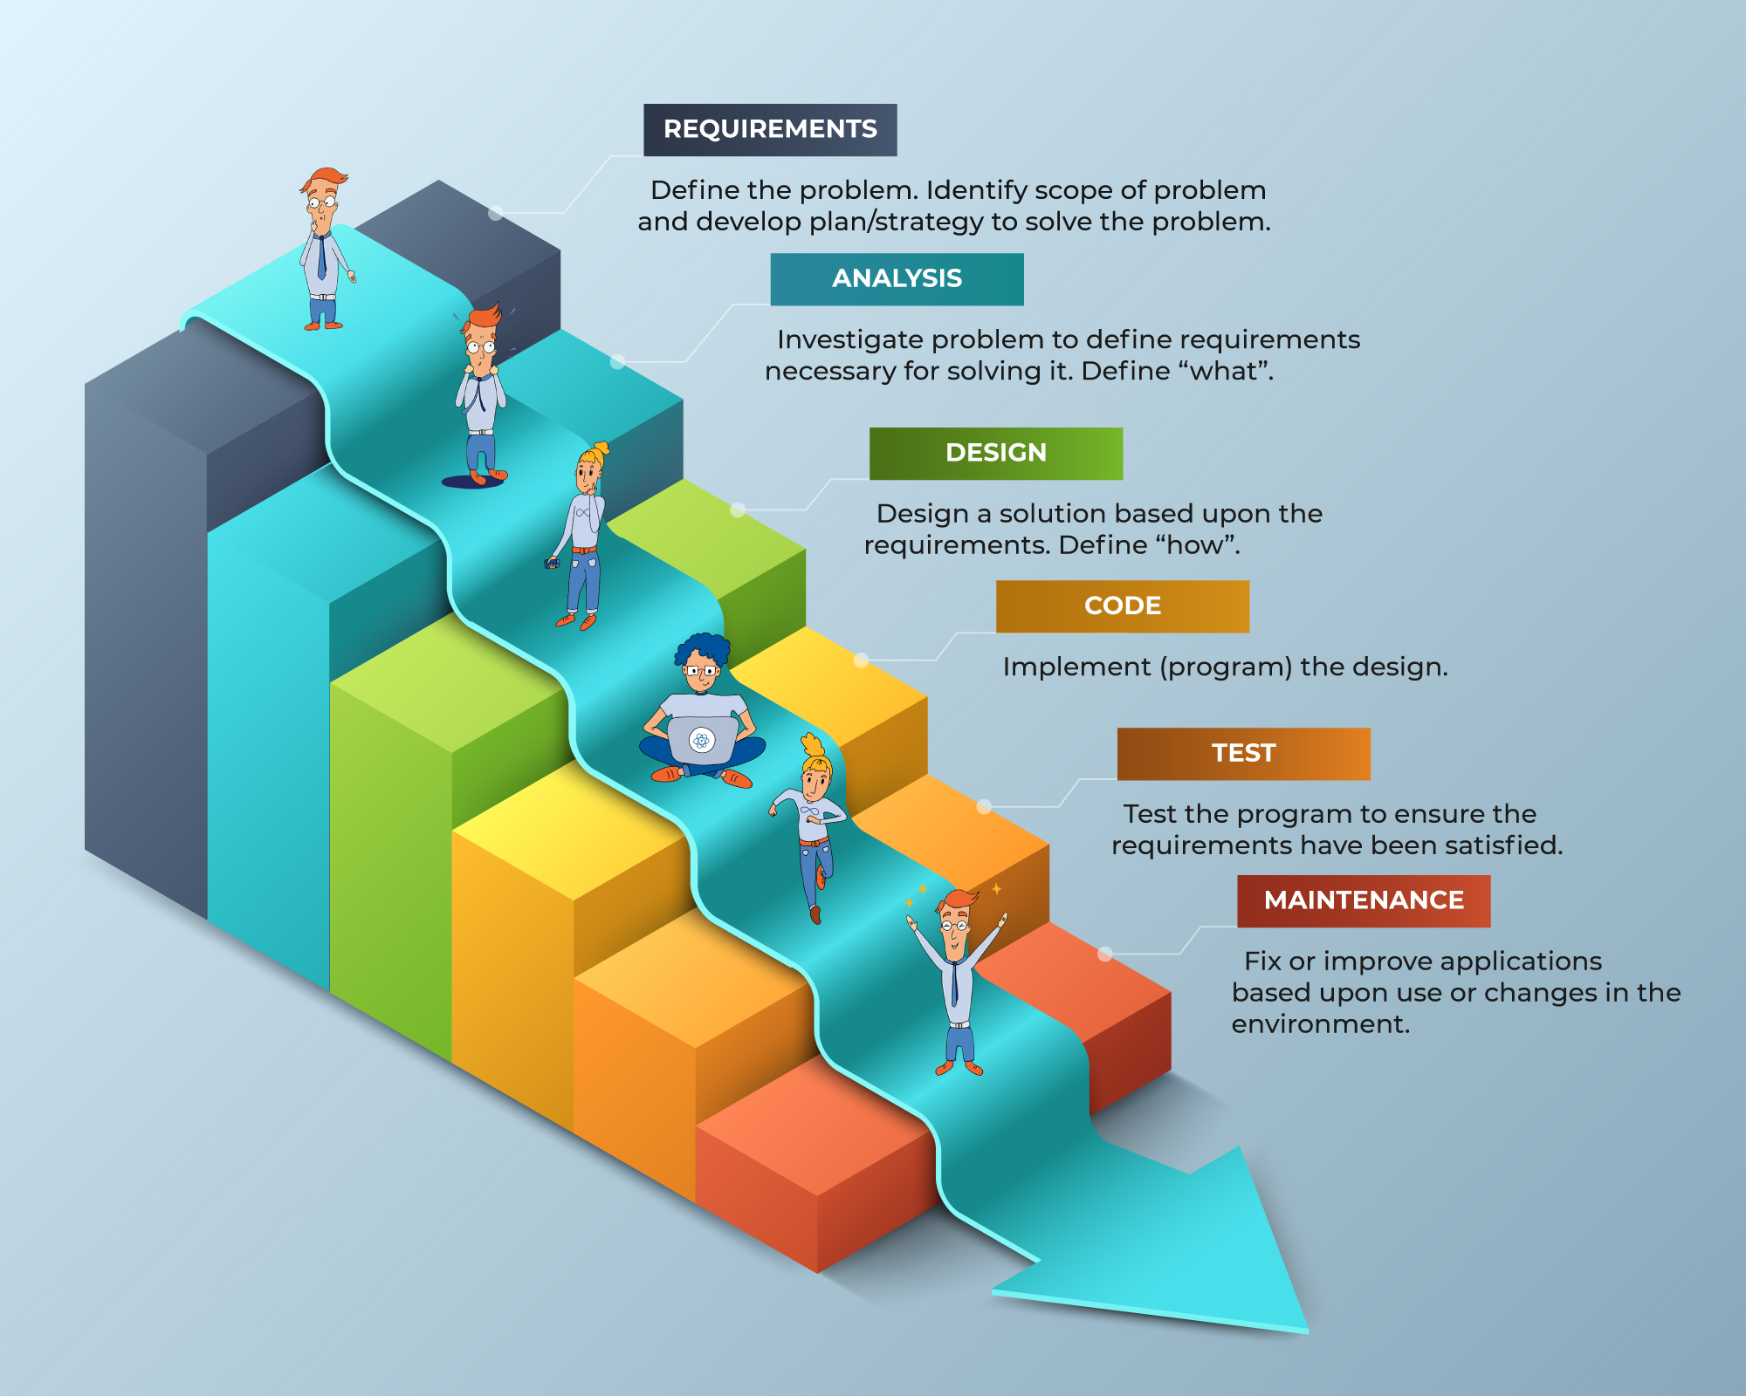
Software Engineering Methodologies: Waterfall
Notes:
Early approaches to software engineering insisted on performing requirements analysis, design, implementation, and testing in a strictly sequential manner. The belief was that too much was at risk during the development of a large software system to allow for variations. As a result, software engineers insisted that the entire requirements specification of the system be completed before beginning the design and, likewise, that the design be completed before beginning implementation. The result was a development process now referred to as the waterfall model, an analogy to the fact that the development process was allowed to flow in only one direction.
Figure from: https://kruschecompany.com/waterfall-software-development-methodology/

Slide 16
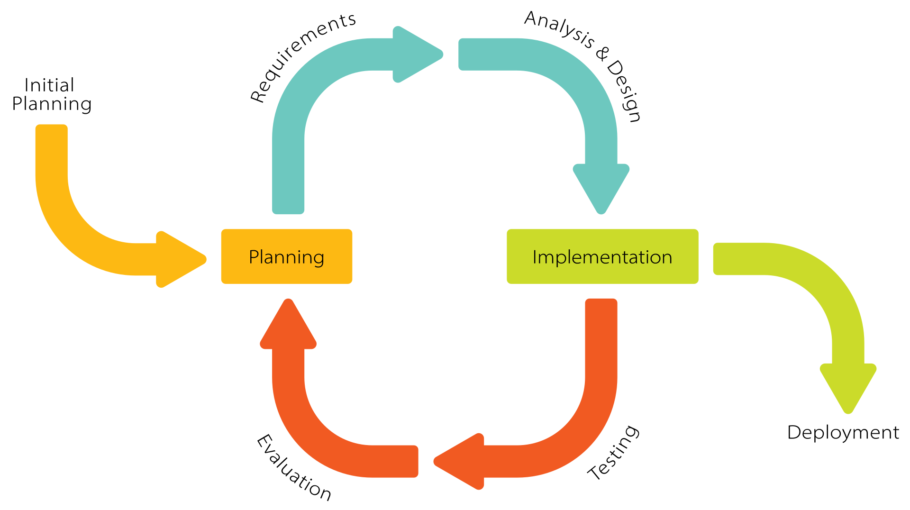
Software Engineering Methodologies: Iterative & Incremental
Notes:
In recent years, software engineering techniques have changed to reflect the
contradiction between the highly structured environment dictated by the waterfall model and the “free-wheeling,” trial-and-error process that is often vital to creative problem solving. This is illustrated by the emergence of the incremental model for software development. Following this model, the desired software system is constructed in increments—the first being a simplified version of the
final product with limited functionality. Once this version has been tested and
perhaps evaluated by the future user, more features are added and tested in an
incremental manner until the system is complete. For example, if the system
being developed is a patient records system for a hospital, the first increment may
incorporate only the ability to view patient records from a small sample of the
entire record system. Once that version is operational, additional features, such
as the ability to add and update records, would be added in a stepwise manner.
Another model that represents the shift away from strict adherence to the waterfall model is the iterative model, which is similar to, and in fact sometimes equated with, the incremental model, although the two are distinct. Whereas the incremental model carries the notion of extending each preliminary version of a product into a larger version, the iterative model encompasses the concept of refining each version. In reality, the incremental model involves an underlying iterative process, and the iterative model may incrementally add features.
Incremental and iterative models sometimes make use of the trend in software development toward prototyping in which incomplete versions of the proposed system, called prototypes, are built and evaluated. In the case of the incremental model these prototypes evolve into the complete, final system— a process known as evolutionary prototyping.

Slide 17
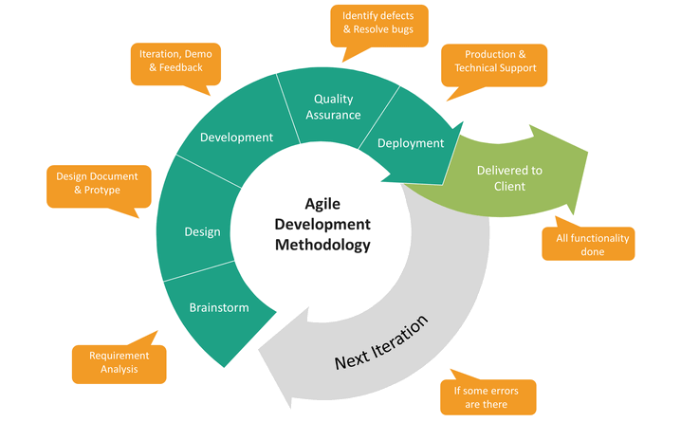
Software Engineering Methodologies: Agile
Notes:
Perhaps the most pronounced shift from the waterfall model is represented by the collection of methodologies known as agile methods, each of which proposes early and quick implementation on an incremental basis, responsiveness to changing requirements, and a reduced emphasis on rigorous requirements analysis and design. One example of an agile method is extreme programming (XP). Following the XP model, software is developed by a team of less than a dozen individuals working in a communal work space where they freely share ideas and assist each other in the development project. The software is developed incrementally by means of repeated daily cycles of informal requirements analysis, designing, implementing, and testing. Thus, new expanded versions of the software package appear on a regular basis, each of which can be evaluated by the project’s stakeholders and used to point toward further increments. In summary, agile methods are characterized by flexibility, which is in stark contrast to the waterfall model that conjures the image of managers and programmers working in individual offices while rigidly performing well-defined portions of the overall software development task.
Figure from: https://www.javatpoint.com/software-engineering-agile-model

Slide 18
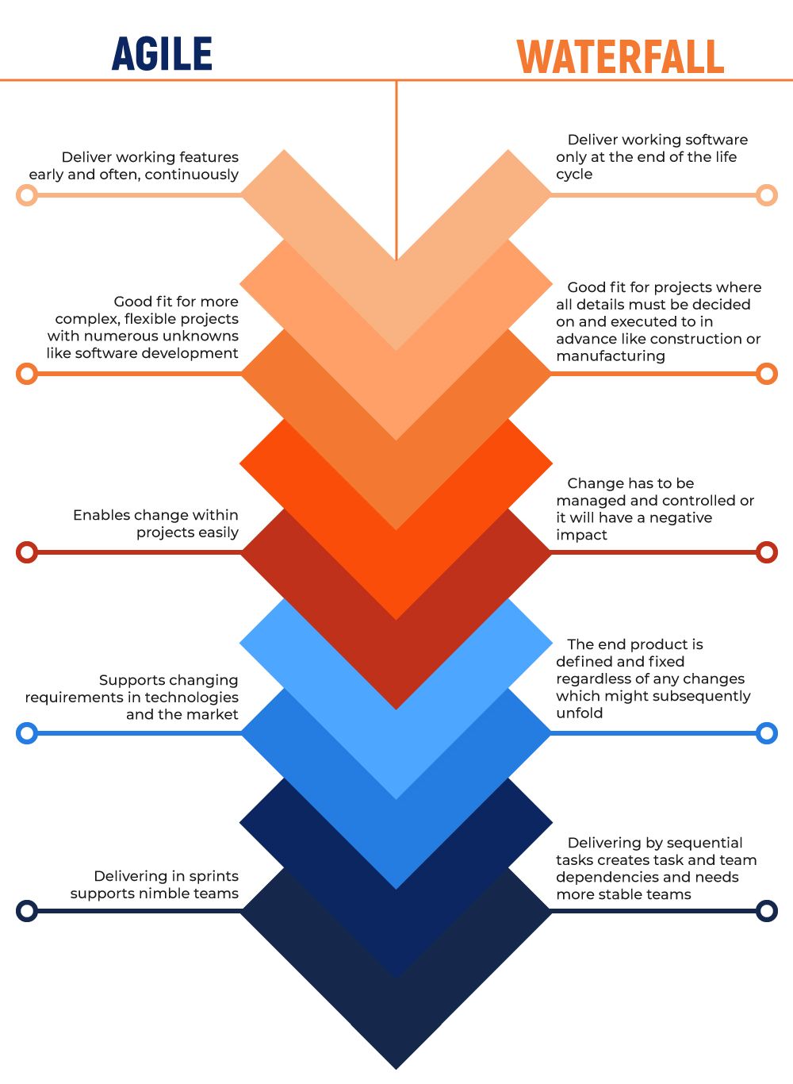
Software Engineering
Methodologies
Notes:
Figure from: https://kruschecompany.com/waterfall-software-development-methodology/

Slide 19
Tools of the Trade
In this section we investigate some of the modeling techniques and notational systems used during the analysis and design stages of software development.

Slide 20
Dataflow
Although the imperative paradigm seeks to build software in terms of procedures or functions, a way of identifying those functions is to consider the data to be manipulated rather than the functions themselves.
Dataflow analysis leads to the identification of functions.
A dataflow diagram is a means of representing the information gained from such dataflow studies.
Assist in identifying procedures during the design stage of software development,
useful when trying to gain an understanding of the proposed system during the analysis stage.
improves communication between clients and software engineers

Slide 21
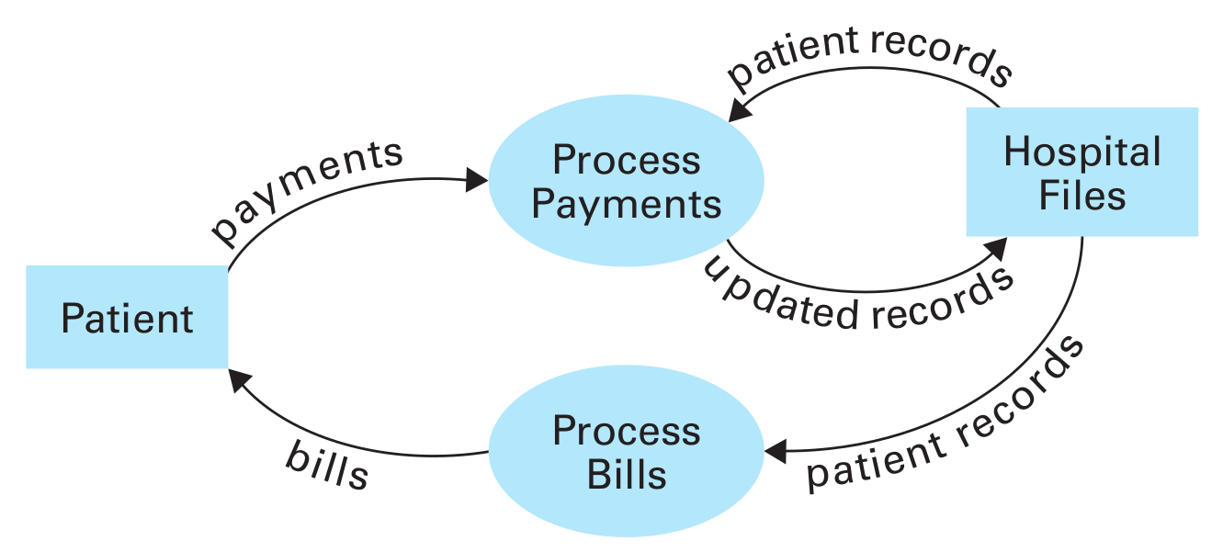
Dataflow
In a dataflow diagram,
arrows represent data paths,
ovals represent points at which data manipulation occurs, and
rectangles represent data sources and stores.
Notes:
Figure 7.8 displays an elementary dataflow diagram representing a hospital’s patient billing system. Note that
the diagram shows that Payments (flowing from patients) and PatientRecords
(flowing from the hospital’s files) merge at the oval ProcessPayments from which
UpdatedRecords flow back to the hospital’s files.

Slide 22
Unified Modeling Language
Modern collection of tools
Has been developed with the object-oriented paradigm in mind.
Use case diagram:
Captures the image of the proposed system from the user’s point of view
Depicts the proposed system as a large rectangle in which
interactions (called use cases) between the system and its users are represented as ovals and
users of the system (called actors) are represented as stick figures (even though an actor may not be a person).

Slide 23
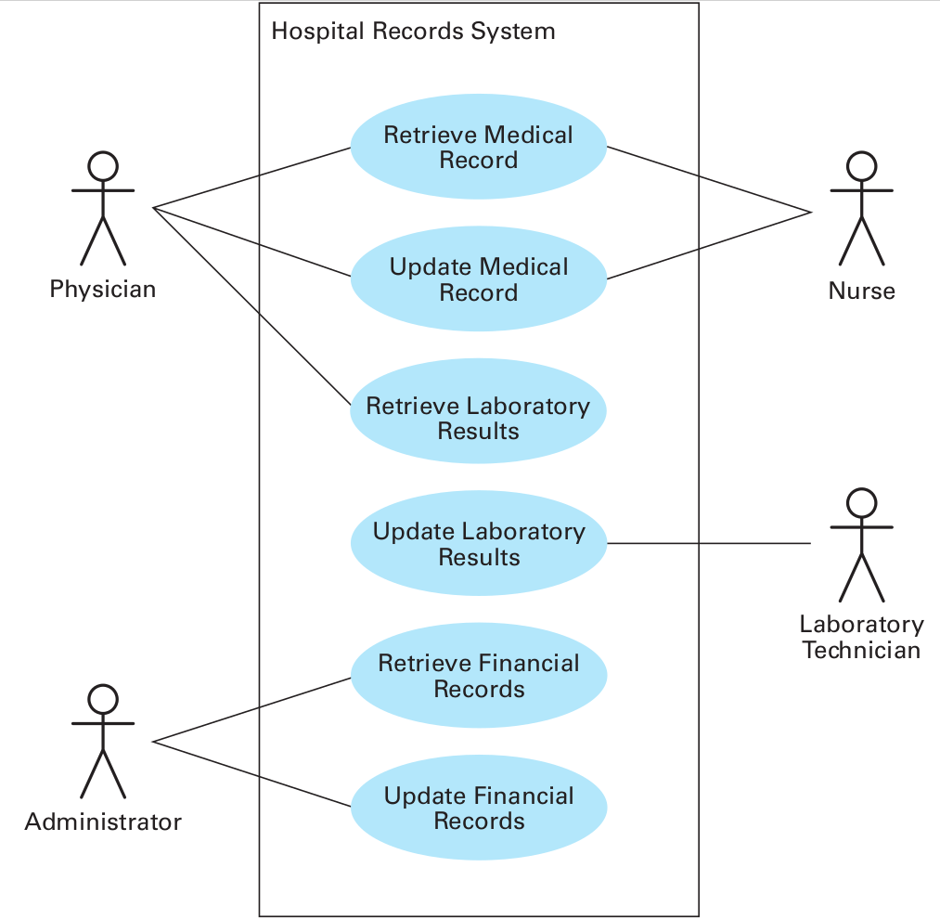
A simple use case diagram
Notes:
The diagram in Figure 7.9 indicates that the proposed Hospital Records System will be used by both
Physicians and Nurses to Retrieve Medical Records.

Slide 24

Unified Modeling Language
Class diagram:
A notational system for representing the structure of classes and relationships between classes.
Classes are represented by rectangles and
Associations are represented by lines.
Association lines may or may not be labeled.
If they are labeled, a bold arrowhead can be used to indicate the direction.
A class diagram can also convey the multiplicities of those associations.
Notes:
Whereas use case diagrams view a proposed software system from the outside, UML offers a variety of tools for representing the internal object-oriented design of a system. One of these is the class diagram, which is a notational system for representing the structure of classes and relationships between classes (called associations in UML vernacular).
Classes are represented by rectangles and
Associations are represented by lines.
Association lines may or may not be labeled.
If they are labeled, a bold arrowhead can be used to indicate the direction in which the label should be read.
As an example, consider the relationships between physicians, patients, and hospital rooms.
We assume that objects representing these entities are constructed from the classes Physician, Patient, and Room, respectively.
Figure 7.10 shows how the relationships among these classes could be represented in a UML class diagram.
For example, in Figure 7.10 the arrowhead following the label cares for indicates that a physician cares for a patient rather than a patient cares for a physician.
Sometimes association lines are given two labels to provide terminology for reading the association in either direction. This is exemplified in Figure 7.10 in the association between the classes Patient and Room.
In addition to indicating associations between classes, a class diagram can also convey the multiplicities of those associations.
In particular, Figure 7.10
indicates that each patient can occupy one room and each room can host zero
or one patient. (We are assuming that each room is a private room.) An asterisk
is used to indicate an arbitrary nonnegative number. Thus, the asterisk in Fig-
ure 7.10 indicates that each physician may care for many patients, whereas the
1 at the physician end of the association means that each patient is cared for by
only one physician. (Our design considers only the role of primary physicians.)

Slide 25
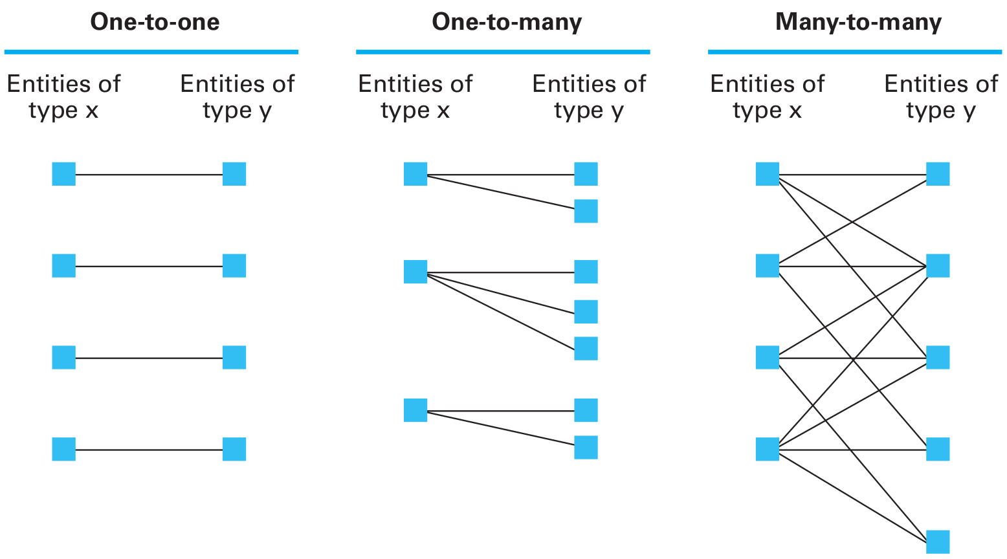
Unified Modeling Language
Class diagram:
Association multiplicities occur in three basic forms
Notes:
Association multiplicities occur in three basic forms: one-to-one relationships, one-to-many relationships, and many-to-many relationships as summarized in Figure 7.11.
A one-to-one
relationship is exemplified by the association between patients and occupied
private rooms in that each patient is associated with only one room and each
room is associated with only one patient. A one-to-many relationship is exem-
plified by the association between physicians and patients in that one physician is
associated with many patients and each patient is associated with one (primary)
physician. A many-to-many relationship would occur if we included consulting
physicians in the physician–patient relationship. Then each physician could be
associated with many patients and each patient could be associated with many
physicians.

Slide 26
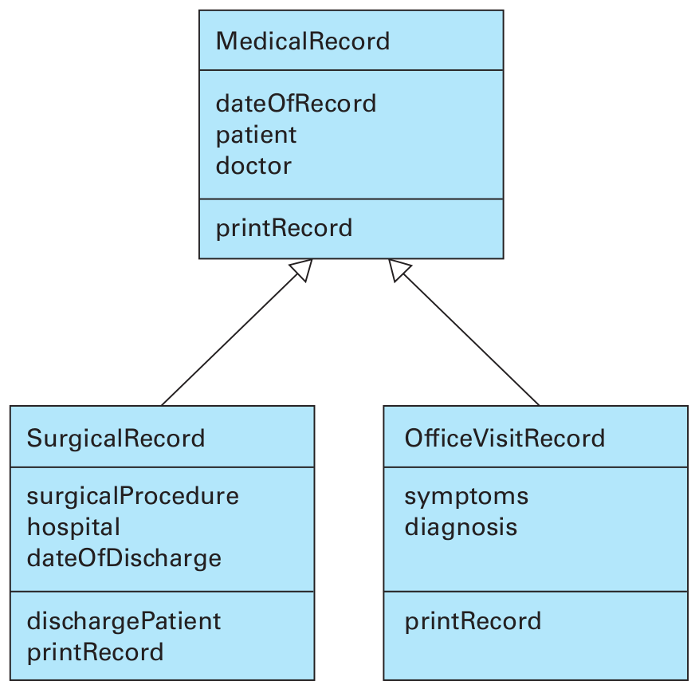
Unified Modeling Language
Class diagram:
A class diagram depicting generalizations
Notes:
In an object-oriented design it is often the case that one class represents
a more specific version of another. In those situations we say that the latter
class is a generalization of the former. UML provides a special notation for rep-
resenting generalizations. An example is given in Figure 7.12, which depicts
the generalizations among the classes MedicalRecord, SurgicalRecord, and
­OfficeVisitRecord. There the associations between the classes are represented
by arrows with hollow arrowheads, which is the UML notation for associations
that are generalizations. Note that each class is represented by a rectangle con-
taining the name, attributes, and methods of the class in the format introduced
in Figure 7.4. This is UML’s way of representing the internal characteristics of
a class in a class diagram. The information portrayed in Figure 7.12 is that the
class MedicalRecord is a generalization of the class SurgicalRecord as well as a
generalization of ­OfficeVisitRecord. That is, the classes SurgicalRecord and
­OfficeVisitRecord contain all the features of the class MedicalRecord plus
those features explicitly listed inside their appropriate rectangles. Thus, both the
SurgicalRecord and the ­OfficeVisitRecord classes contain patient, doctor,
and date of record, but the SurgicalRecord class also contains surgical proce-
dure, hospital, discharge date, and the ability to discharge a patient, whereas
the OfficeVisitRecord class contains symptoms and diagnosis. All three classes have the ability to print the medical record. The printRecord method in
­SurgicalRecord and OfficeVisitRecord are specializations of the printRecord
method in MedicalRecord, each of which will print the information specific to
its class.
a natural way of implementing generalizations in an object-oriented programming environment is to use inheritance.

Slide 27
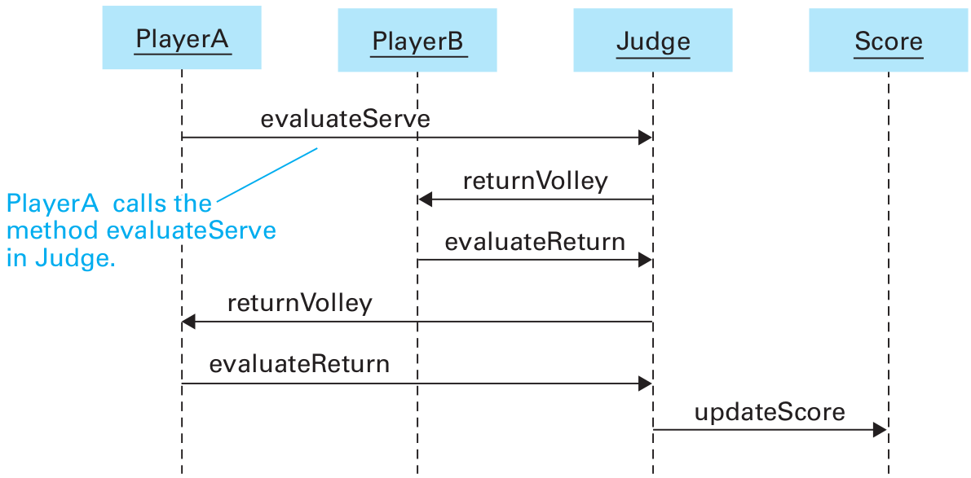
Unified Modeling Language
Interaction diagrams: sequence diagram
that depicts the communication between the individuals
Notes:
Class diagrams represent static features of a program’s design. They do not represent sequences of events that occur during execution.
To express such dynamic features, UML provides a variety of diagram types that are collectively known as interaction diagrams.
One type of interaction diagram is the sequence diagram that depicts the communication between the individuals (such as actors, complete software components, or individual objects) that are involved in performing a task. These diagrams are similar to Figure 7.5 in that they represent
the individuals by rectangles with dashed lines extending downward. Each rect-
angle together with its dashed line is called a life line. Communication between
the individuals is represented by labeled arrows connecting the appropriate life
line, where the label indicates the action being requested. These arrows appear
chronologically as the diagram is read from top to bottom. The communication
that occurs when an individual completes a requested task and returns control
back to the requesting individual, as in the traditional return from a procedure,
is represented by an unlabeled arrow pointing back to the original life line.

Slide 28
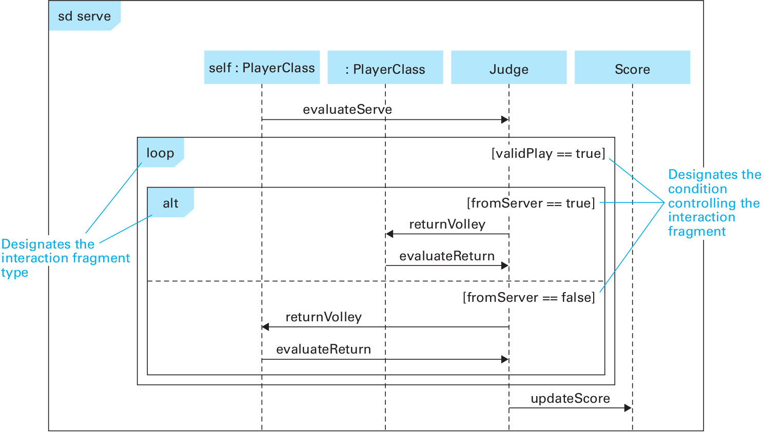
Unified Modeling Language
A sequence diagram depicting a generic volley
Notes:
Thus, Figure 7.5 is essentially a sequence diagram. However, the syntax of
Figure 7.5 alone has several shortcomings. One is that it does not allow us to cap-
ture the symmetry between the two players. We must draw a separate diagram to
represent a volley starting with a serve from PlayerB, even though the interac-
tion sequence is very similar to that when PlayerA serves. Moreover, whereas
Figure 7.5 depicts only a specific volley, a general volley may extend indefinitely.
Formal sequence diagrams have techniques for capturing these variations in a
single diagram, and although we do not need to study these in detail, we should
still take a brief look at the formal sequence diagram shown in Figure 7.13, which
depicts a general volley based on our tennis game design.
Note also that Figure 7.13 demonstrates that an entire sequence diagram is
enclosed in a rectangle (called a frame). In the upper left-hand corner of the
frame is a pentagon containing the characters sd (meaning “sequence diagram”) followed by an identifier. This identifier may be a name identifying the overall
sequence or, as in Figure 7.13, the name of the method that is called to initiate
the sequence. Note that in contrast to Figure 7.5, the rectangles representing the
players in Figure 7.13 do not refer to specific players but merely indicate that
they represent objects of the “type” PlayerClass. One of these is designated
self, meaning that it is the one whose serve method is activated to initiate the
sequence.
The other point to make regarding Figure 7.13 deals with the two inner rect-
angles. These are interaction fragments, which are used to represent alternative
sequences within one diagram. Figure 7.13 contains two interaction fragments.
One is labeled “loop,” the other is labeled “alt.” These are essentially the while
and if-else structures that we first encountered in Python in Section 5.2. The
“loop” interaction fragment indicates that the events within its boundaries are to
be repeated as long as the Judge object determines that the value of validPlay
is true. The “alt” interaction fragment indicates that one of its alternatives is to
be performed depending on whether the value of fromServer is true or false.

Slide 29
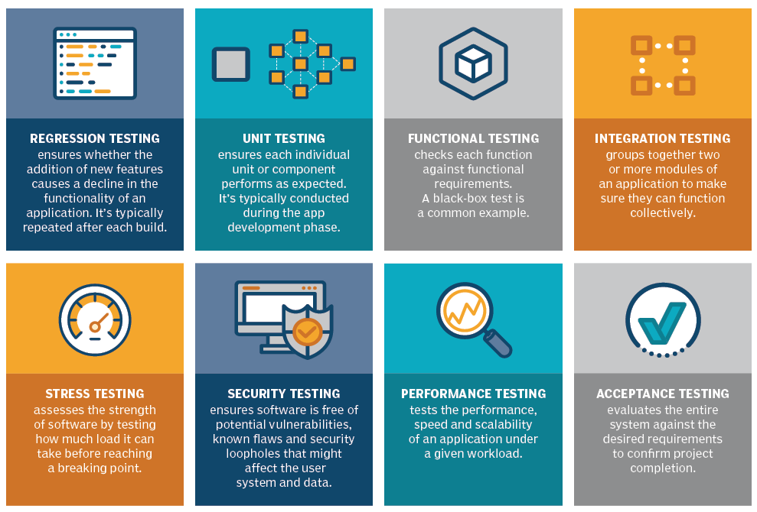
Software Testing
Notes:
Figure from: https://www.techtarget.com/whatis/definition/software-testing
We cannot guarantee that a piece of software is correct via testing unless we run enough tests to exhaust all possible scenarios.
But, even in simple programs, there may be billions of different paths that could potentially be traversed.
Thus, testing all possible paths within a complex program is an impossible task
The following are the main types of software testing methodologies:
Integration testing. This groups together two or more modules of an application to ensure they function collectively. This type of testing also reveals interface, communication and data flow defects between modules.
Unit testing. Typically conducted during the application development phase, the purpose of unit testing is to ensure that each individual unit or component performs as expected. This is a type of white box testing and test automation tools -- such as NUnit, JUnit and xUnit -- are typically used to execute these tests.
Functional testing. This entails checking functions against functional requirements. A common way to conduct functional testing is by using the black box testing
Security testing. This ensures the software is free of potential vulnerabilities, known flaws and security loopholes that might affect the user system and data. Security testing is generally conducted through penetration testing.
Performance testing. This tests the performance and speed of an application under a given workload.
Regression testing. This verifies whether adding new features causes a decline in the functionality of an application.
Stress testing. This assesses the strength of software by testing how much load it can take before reaching a breaking point. This is a type of nonfunctional test.
Acceptance testing. This evaluates the entire system against the desired requirements and ensures the project is complete.

Slide 30
Documentation
Documentation is an important part of a final software package, and its development is, therefore, an important topic in software engineering.
Software documentation serves three purposes, leading to three categories of documentation:
user documentation,
system documentation, and
technical documentation.

Slide 31
User documentation
The purpose of user documentation is to explain the features of the software and describe how to use them.
intended to be read by the user of the software and is therefore expressed in the terminology of the application.
an important marketing tool
help packages
Notes:
The purpose of user documentation is to explain the features of the software and describe how to use them.
It is intended to be read by the user of the software and is therefore expressed in the terminology of the application.
Today, user documentation is recognized as an important marketing tool.
Good user documentation combined with a well-designed user interface makes a software package accessible and thus increases its sales.
User documentation traditionally takes the form of a physical book or booklet, but in many cases the same information is included as part of the software itself.
This allows a user to refer to the documentation while using the software.
In this case the information may be broken into small units, sometimes called help packages, that may appear on the display screen automatically if the user dallies too long between commands.

Slide 32
System documentation
The purpose of system documentation is to describe the software’s internal composition so that the software can be maintained later in its life cycle.
2 major components of system documentation:
The source version of all the programs in the system
The design documents including
the software requirements specification and
records showing how these specifications were obtained during design
Notes:
The purpose of system documentation is to describe the software’s internal composition so that the software can be maintained later in its life cycle.
A major component of system documentation is the source version of all the programs in the system.
It is important that these programs be presented in a readable format, which is why software engineers support the use of well-designed, high-level programming languages, the use of comment statements for annotating a program, and a modular design that allows each module to be presented as a coherent unit.
In fact, most companies that produce software products have adopted conventions for their employees to follow when writing programs.
These include indentation conventions for organizing a program on the written page; naming conventions that establish a distinction between names of different program constructs such as variables, constants, objects, and classes; and documentation conventions to ensure that all programs are sufficiently documented.
Such conventions establish uniformity throughout a company’s software, which ultimately simplifies the software maintenance process.
Another component of system documentation is a record of the design documents including the software requirements specification and records showing how these specifications were obtained during design.
This information is useful during software maintenance because it indicates why the software was implemented as it was—information that reduces the chance that changes made during maintenance will disrupt the integrity of the system.

Slide 33
Technical documentation
The purpose of technical documentation is to describe how a software system should be installed and serviced
(such as adjusting operating parameters, installing updates, and reporting problems back to the software’s developer).
The distinction between technical documentation and user documentation is blurred in the PC arena
Especially for the cases where the user is the person who also installs and services the software
However, in multiuser environments, the distinction is sharper.
Notes:
The purpose of technical documentation is to describe how a software system should be installed and serviced (such as adjusting operating parameters, installing updates, and reporting problems back to the software’s developer).
Technical documentation of software is analogous to the documentation provided to mechanics in the automobile industry.
This documentation does not discuss how the car was designed and constructed (analogous to system documentation), nor does it explain how to drive the car and operate its heating/cooling system (analogous to user documentation).
Instead, it describes how to service the car’s components—for example, how to replace the transmission or how to track down an intermittent electrical problem.
The distinction between technical documentation and user documentation is blurred in the PC arena because the user is often the person who also installs and services the software.
However, in multiuser environments, the distinction is sharper.
Therefore, technical documentation is intended for the system administrator who is responsible for servicing all the software under his or her jurisdiction, allowing the users to access the software packages as abstract tools.

Slide 34

Extra Reading
Brookshear JG, Smith D, Brylow D.
“Computer science: an overview”.
Read the following section in the textbook.
Chapter: 7.9 Software Ownership and Liability
Summarize the section in 1 page (no figure should be included.)
Template for summarization assignments:
https://docs.google.com/document/d/1i1tU3AdIvPgRxqzGmXrsnVVCRXws5V3caDTCPMbPJ_0/edit?usp=sharing
Notes:
https://clipart-library.com/reading-clipart.html

Slide 35
Research Themes
Artificial Intelligence and Software Engineering
Software Project Management
Software Quality
Brain Computer Interaction

Slide 36
COM1013
INTRODUCTION TO COMPUTER SCIENCE
Lecturer: Begüm MUTLU BİLGE, PhD
begummutlubilge+com1013@gmail.com (recommended)
bmbilge@ankara.edu.tr

